Slide 1


Slide 2
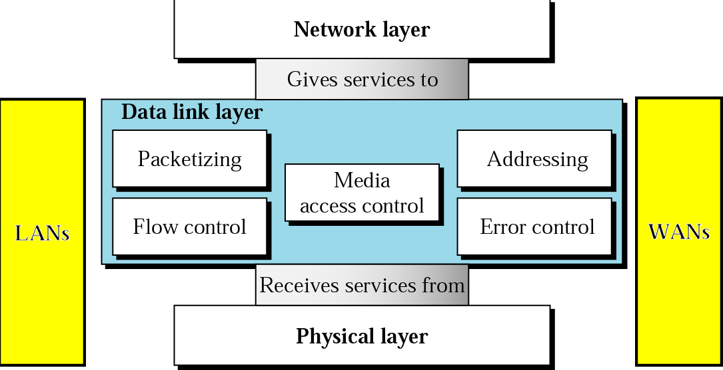
OVERVIEW OF DLL
The data link layer is responsible for moving frames from one node to the next.
Specific responsibilities of the data link layer include framing, addressing, flow control, error control, and media access control.
2

Slide 3
DLL DESIGN ISSUES
Services Provided to the Network Layer
Framing
Error Control
Flow Control

Slide 4
SERVICES PROVIDED TO THE NETWORK LAYER
The function of the data link layer is to provide services to the network layer.
The principal service is transferring data from the network layer on the source machine to the network layer on the destination machine.
The data link layer can be designed to offer various services. The actual services offered can vary from system to system.
Three reasonable possibilities that are commonly provided are
Unacknowledged Connectionless service
Acknowledged Connectionless service
Acknowledged Connection-Oriented service

Slide 5
UNACKNOWLEDGED CONNECTIONLESS SERVICE
Unacknowledged connectionless service consists of having the source machine send independent frames to the destination machine without having the destination machine acknowledge them.
No logical connection is established before and or released afterward. If a frame is lost due to noise on the line, no attempt is made to detect the loss or recover from it in the data link layer.
This class of service is appropriate when the error rate is very low so that recovery is left to higher layers. It is also appropriate for real- time traffic, such as voice, in which late data are worse than bad data. Most LANs use unacknowledged connectionless service in the data link layer.

Slide 6
ACKNOWLEDGED CONNECTIONLESS SERVICE
When this service is offered, there are still no logical connections used, but each frame sent is individually acknowledged.
In this way, the sender knows whether a frame has arrived correctly. If it has not arrived within a specified time interval, it can be sent again. This service is useful over unreliable channels, such as wireless systems.
Adding Ack in the DLL rather than in the Network Layer is just an optimization and not a requirement. If individual frames are acknowledged and retransmitted, entire packets get through much faster. On reliable channels, such as fiber, the overhead of a heavyweight data link protocol may be unnecessary, but on wireless channels, with their inherent unreliability, it is well worth the cost.

Slide 7
ACKNOWLEDGED CONNECTION-ORIENTED SERVICE
Here, the source and destination machines establish a connection before any data are transferred. Each frame sent over the connection is numbered, and the data link layer
guarantees Furthermore,
that each frame sent is indeed received. it guarantees that each frame is received
exactly once and that all frames are received in the right
Order.
When connection-oriented service is used, transfers go through three distinct phases.
  In the first phase, the connection is established by having both sides initialize variables and counters needed to keep track of which frames have been received and which ones have not.
  In the second phase, one or more frames are actually transmitted.
In the third and final phase, the connection is released, freeing up the variables, buffers, and other resources used to maintain the connection
8

Slide 8
FRAMING
DLL translates the physical layer's raw bit stream into discrete units (messages) called frames.
Character Count
Flag byte with Byte Stuffing
Starting and ending flag with bite stuffing
Encoding Violations

Slide 9
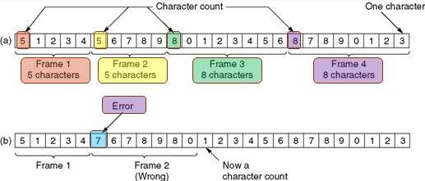
FRAMING – CHARACTER COUNT
The first framing method uses a field in the header to specify the number of characters in the frame. When the data link layer at the destination sees the character count, it knows how many characters follow and hence where the end of the frame is.
11

Slide 10

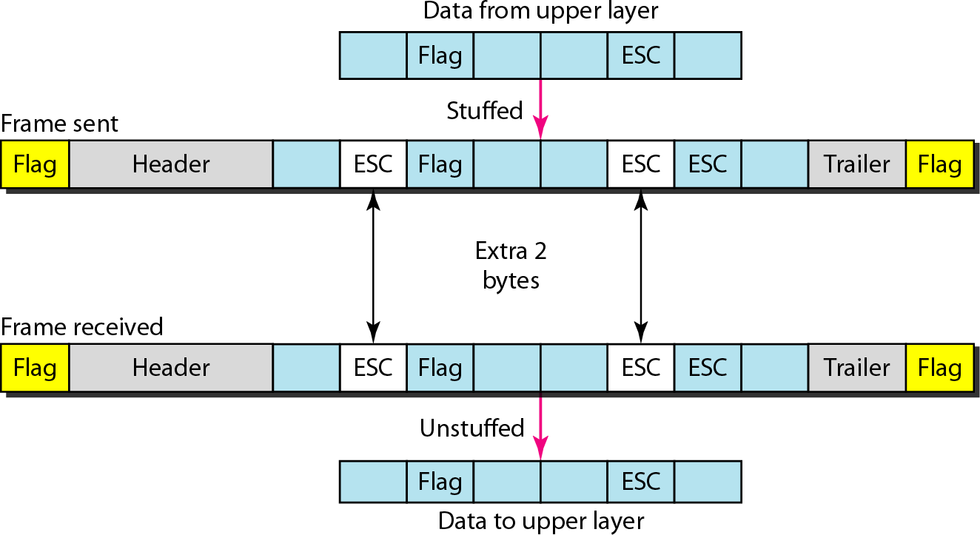

Slide 11

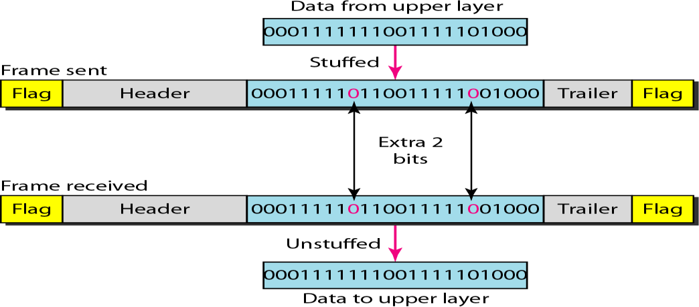

Slide 12
FLOW CONTROL
Flow control is the process of managing the rate of data transmission between two nodes to prevent a fast sender from overwhelming a slow receiver
Flow control deals with the speed of the sender to match that of the receiver.
Two Approaches:
  feedback-based flow control, the receiver sends back information to the sender giving it permission to send more data or at least telling the sender how the receiver is doing
  rate-based flow control, the protocol has a built-in mechanism that limits the rate at which senders may transmit data, without using feedback from the receiver.

Slide 13
ERROR CORRECTION AND DETECTION
It is physically impossible for any data recording or transmission medium to be 100% perfect 100% of the time over its entire expected useful life.
Thus, error detection and correction is critical to accurate data transmission, storage and retrieval.
Detecting and correcting errors requires redundancy -- sending additional information along with the data.

Slide 14

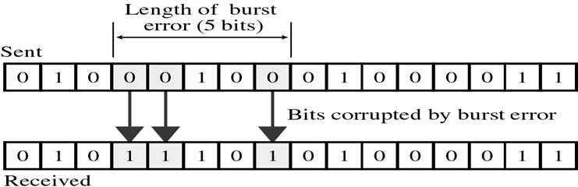
TYPES OF ERRORS
There are two main types of errors in transmissions:
1. Single bit error : It means only one bit of data unit is changed from 1 to 0 or from 0 to 1.
2. Burst error : It means two or more bits in data unit are changed from 1 to 0 from 0 to 1. In burst error, it is not necessary that only consecutive bits are changed. The length of burst error is measured from first changed bit to last changed bit

Slide 15
parity
Odd parity
Total number 1 should be odd
Eg: 011001101 – 5 odd
Even Parity
Total number 1 should be even
Eg: 0110011011 – 6 even

Slide 16
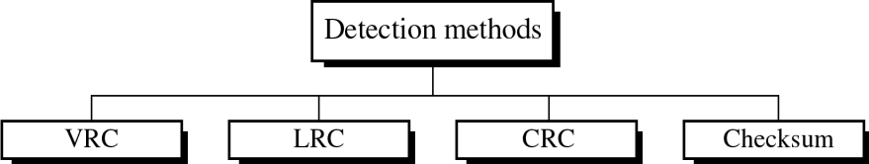
ERROR DETECTION
Error
A condition when the receiver’s information does not match with the sender’s information. During transmission, digital signals suffer from noise that can introduce errors in the binary bits travelling from sender to receiver. That means a 0 bit may change to 1 or a 1 bit may change to 0.
Error Detecting Codes
Whenever a message is transmitted, it may get scrambled by noise or data may get corrupted.
To avoid this, we use error-detecting codes which are additional data(redundant) added to a given digital message to help us detect if any error has occurred during transmission of the message.

Slide 17
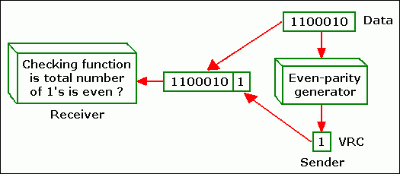
VERTICAL REDUNDANCY CHECK (VRC)
Most common and inexpensive mechanism error detection which also called parity check.
A redundant bit (parity bit) is appended to every data unit so that the total number of 1s in the unit becomes even, if there is even-parity check used.
Ex: 0110011 Ans 01100110
There are even-parity check and odd-parity check. For odd-parity check, the total number of 1s in the unit is odd.
Ex : 0110001 Ans 01100011
25

Slide 18
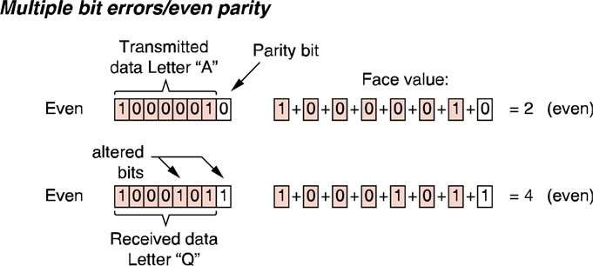
EXAMPLE OF VRC
26

Slide 19
Advantages of VRC
The advantages of VRC are it can detect all single-bit errors.
It also can detect burst errors as long as the total number of bits changed is odd (1,3,5, etc).
The same holds true for any odd number of errors.
The limitation is it cannot detect errors where the total number of bits changed is even, where the two bits of the data unit are changed. In this case, the total number of 1s is still even.
The VRC checker will add them and return an even number although the data unit contains two errors.
Then the unit will pass a parity check even through the data unit is damaged.
The same holds true for any even number of errors.

Slide 20
Longitudinal Redundancy Checks (LRC)
Longitudinal Redundancy Checks (LRC) seek to overcome the weakness of simple, bit-oriented, one-directional parity checking.
A block of bits is divided into rows then check parity, so we are getting one extra (redundant) row , that redundant row should be added with the whole block.
i.e.,
In this error detection method, a block of bits is organized in a table with rows and columns.
Then the parity bit for each column is calculated and a new row, which are the parity bits for the whole block, is created.
After that the new calculated parity bits are attached to the original data and sends to the receiver.
27

Slide 21
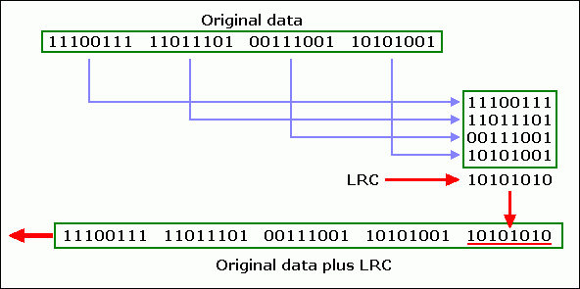
Example
LRC increases the likelihood of detecting burst error. An LRC of n bits can easily detects a burst error of n bits.
However, if two bits in one data unit are damaged and two bits in exactly the same positions in another data unit are also damaged, the LRC checker will not detect an error.

Slide 22
LRC Example
Example 1:
Block of Bits : 11010 01101 10011 00110
Soln : At Sender side
11010
01101
10011
00110
00010
Transmittes data: 11010 01101 10011 00110 00010
At receiver side do it in same manner. We are getting 000000 . So the data will be accepted.
Example 2: 10011 01011 10101 10101
Ans :

Slide 23
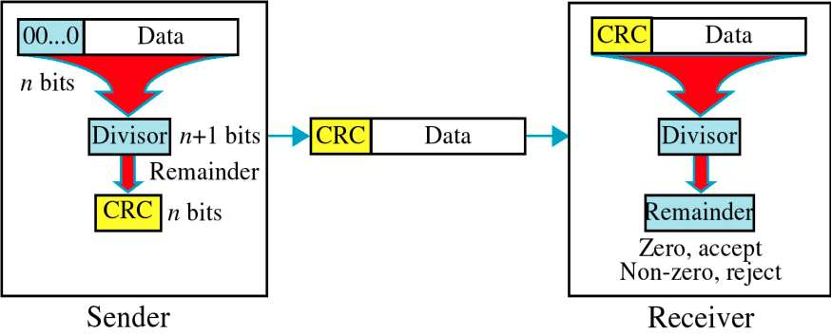
CYCLIC REDUNDANCY CHECK (CRC)

Slide 24
CYCLIC REDUNDANCY CHECK (CRC)
CRC is based on binary division.
In Sender
We have Data and Divisor(n+1)
In CRC, a sequence of redundant bits, called cyclic redundancy check bits, are appended to the end of data unit so that the resulting data unit becomes exactly divisible by a predetermined binary number.
i.e, ‘ n ’ number of 0 ‘s are added to the data unit.
That ‘n’ should be less than the number of bits in divisor.
Binary division is performed of the resultant string with the CRC generator. After division, the remainder so obtained is called as CRC.
At the receiver,
The data unit received at receiver followed by CRC. i.e, Number of 0’s are replaced by CRC.
Again do the binary division with same divisor. If at this step there is no remainder, the data unit is assumed to be correct and is therefore accepted.
A remainder indicates that the data unit has been damaged in transit and therefore must be rejected.

Slide 25
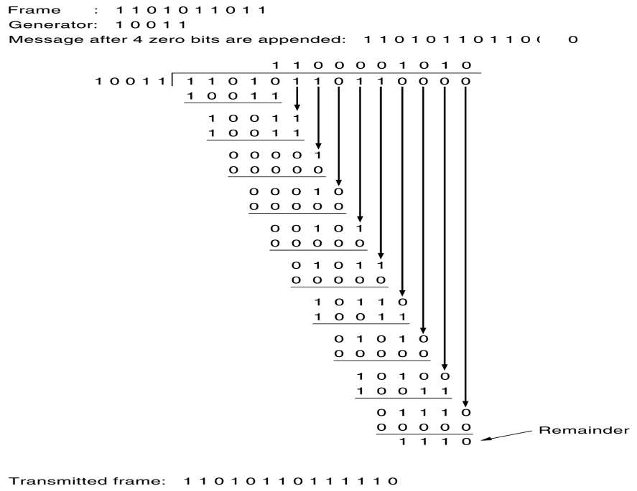

Slide 26
At receiver side, again do binary division for transmitted frame 11010110111110 with same divisor.
1 1 0 0 0 0 1 0 1 0
10011 1 1 0 1 0 1 1 0 1 1 1 1 1 0
1 0 0 1 1
1 0 0 1 1
1 0 0 1 1 1 0 1 1 1
        0 0 0 0 1 1 0 0 1 1
        0 0 0 0 0 0 1 0 0 1
        0 0 0 1 0 0 0 0 0 0
        0 0 0 0 0 1 0 0 1 1
        0 0 1 0 1 1 0 0 1 1
        0 0 0 0 0 0 0 0 0 0
        0 1 0 1 1 0 0 0 0 0
        0 0 0 0 0 0 0 0 0

Slide 27
CRC PERFORMANCE
CRC is a very effective error detection technique. If the divisor is chosen according to the previously mentioned rules, its performance can be summarized as follows:
CRC can detect all single-bit errors
CRC can detect all double-bit errors (three 1’s)
CRC can detect any odd number of errors (X+1)
CRC can detect all burst errors of less than the degree of the polynomial.
CRC detects most of the larger burst errors with a high probability.
For example CRC-12 detects 99.97% of errors with a length 12 or more.
42

Slide 28
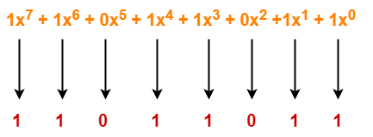
CRC Generator
CRC generator is an algebraic polynomial represented as a bit pattern.
Bit pattern is obtained from the CRC generator using the following rule-
The power of each term gives the position of the bit and the coefficient gives the value of the bit.
Example-
Consider the CRC generator is x⁷ + x⁶ + x⁴ + x³ + x + 1
The corresponding binary pattern is obtained as-
Thus, for the given CRC generator, the corresponding binary pattern is 11011011

Slide 29
Properties Of CRC Generator
The algebraic polynomial chosen as a CRC generator should have at least the following properties-
Rule-1:
It should not be divisible by x.
This condition guarantees that all the burst errors of length equal to the length of polynomial are detected.
Rule-2:
It should be divisible by x+1.
This condition guarantees that all the burst errors affecting an odd number of bits are detected.

Slide 30
Problem
A bit stream 1101011011 is transmitted using the standard CRC method. The generator polynomial is x⁴+x+1. What is the actual bit string transmitted?
Solution
The generator polynomial G(x) = x⁴ + x + 1 is encoded as 10011.
Clearly, the generator polynomial consists of 5 bits.
So, a string of 4 zeroes is appended to the bit stream to be transmitted.
The resulting bit stream is 11010110110000.

Slide 31
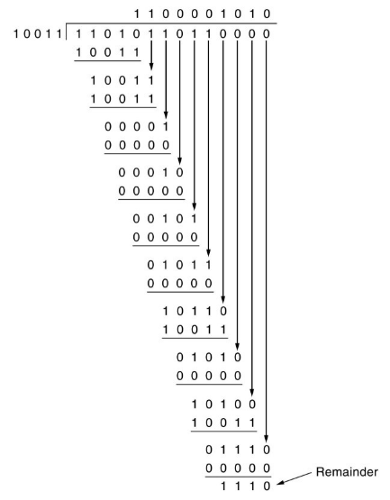
From here, CRC = 1110.The code word to be transmitted is obtained by replacing the last 4 zeroes of 11010110110000 with the CRC.
Thus, the code word transmitted to the receiver = 11010110111110.

Slide 32
Problem-2
A bit stream 10011101 is transmitted using the standard CRC method. The generator polynomial is x³+1.
What is the actual bit string transmitted?
Suppose the third bit from the left is inverted during transmission. How will receiver detect this error?
Solution-
Part-1:
The generator polynomial G(x) = x³ + 1 is encoded as 1001.
Clearly, the generator polynomial consists of 4 bits.
So, a string of 3 zeroes is appended to the bit stream to be transmitted.
The resulting bit stream is 10011101000.
Now, the binary division is performed as-
DO IT FIND ANSWER

Slide 33
From here, CRC = 100.
Now,
The code word to be transmitted is obtained by replacing the last 3 zeroes of 10011101000 with the CRC.
Thus, the code word transmitted to the receiver = 10011101100.
Part-2:
According to the question,
Third bit from the left gets inverted during transmission.
So, the bit stream received by the receiver = 10111101100.
Now,
Receiver receives the bit stream = 10111101100.
Receiver performs the binary division with the same generator polynomial as-
DO IT FIND ANSWER

Slide 34
Getting remainder as 0100
The remainder obtained on division is a non-zero value.
This indicates to the receiver that an error occurred in the data during the transmission.
Therefore, receiver rejects the data and asks the sender for retransmission.

Slide 35


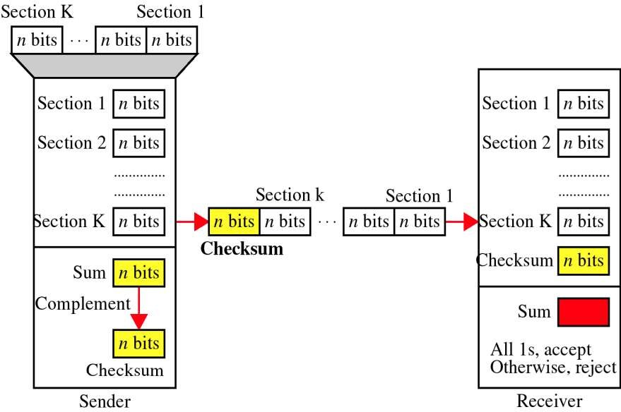
CHECKSUM

Slide 36
Error detection using checksum method involves the following steps
Step-1
At sender side,
If n bit checksum is used, the data unit to be transmitted is divided into segments of n bits.
All the n bit segments are added.
The result of the sum is then complemented using 1’s complement arithmetic.
The value so obtained is called as checksum
Step-2
The data along with the checksum value is transmitted to the receiver.

Slide 37
Step-3
At receiver side,
If n bit checksum is being used, the received data unit is divided into segments of n bits.
All the n bit segments are added along with the checksum value.
The value so obtained is complemented and the result is checked.
Then, following two cases are possible
Case(i): If the result is zero,
Receiver assumes that no error occurred in the data during the transmission.
Receiver accepts the data.
Case(ii): If the result is non-zero,
Receiver assumes that error occurred in the data during the transmission.
Receiver discards the data and asks the sender for retransmission.

Slide 38
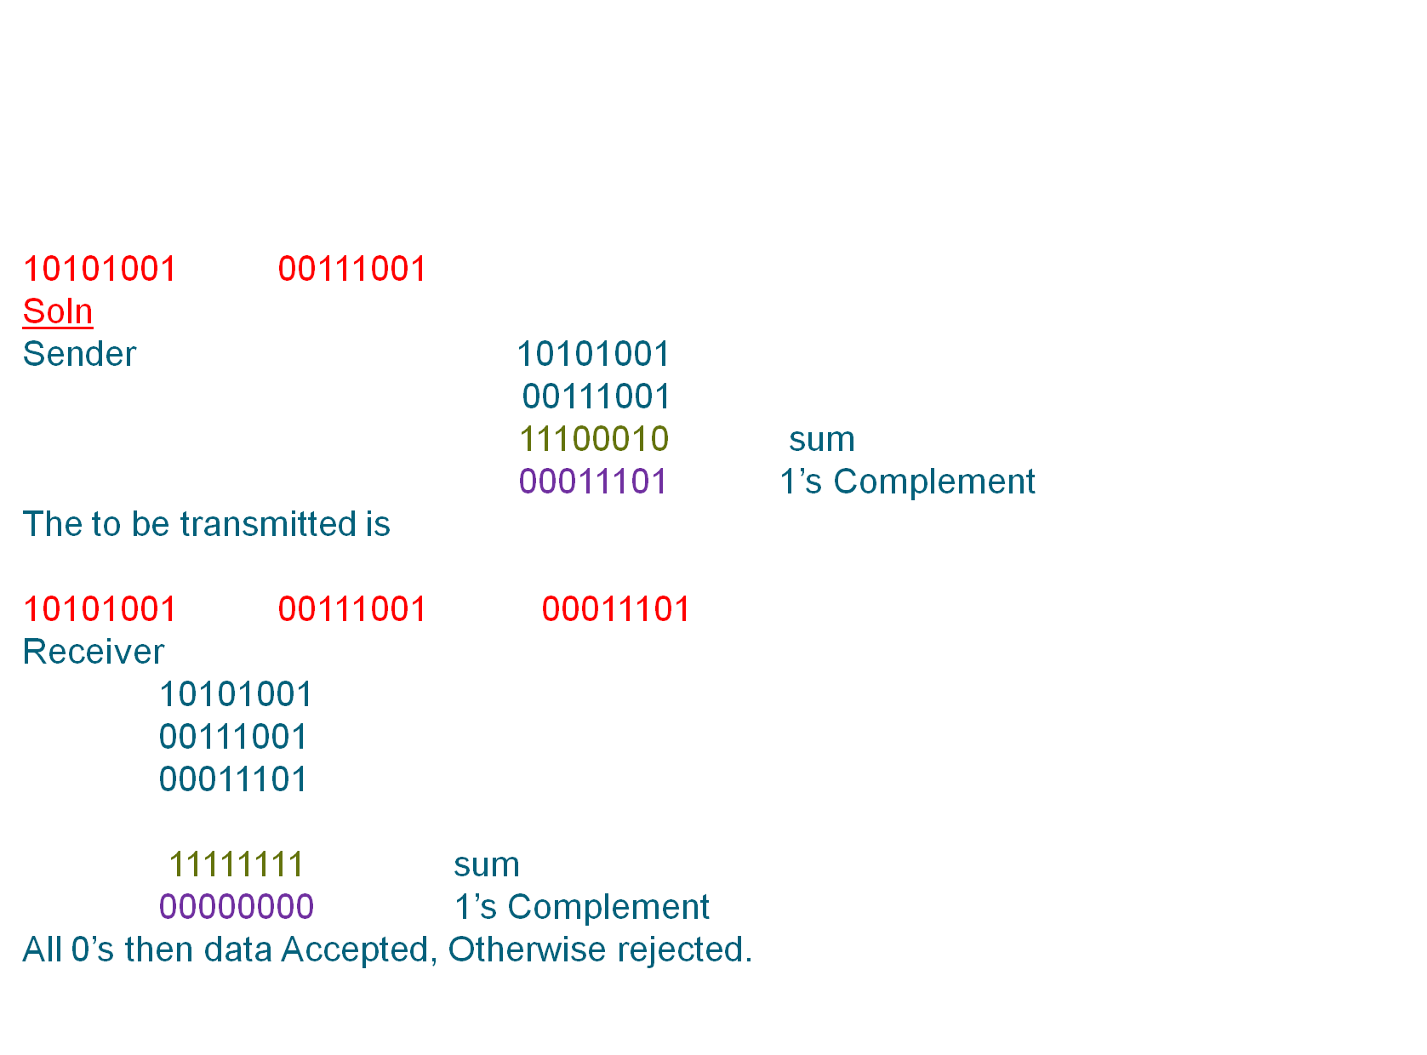
Example

Slide 39
Checksum Vs CRC
CRC is more thorough as opposed to Checksum in checking for errors and reporting.
Checksum is the older of the two programs.
CRC has a more complex computation as opposed to checksum.
Checksum mainly detects single-bit changes in data while CRC
can check and detect double-digit errors.
CRC can detect more errors than checksum due to its more complex function.
A checksum is mainly employed in data validation when implementing software.
A CRC is mainly used for data evaluation in analogue da⁵t⁰a transmission.

Slide 40



ERROR CORRECTION
Once detected, the errors must be corrected
Two Techniques for error correction
  Retransmission (aka Backward error correction)
    Simplest, effective and most commonly used technique –
involves correction by retransmission of data by the sender
    Popularly called Automatic Repeat Request (ARQ)
  Forward Error Correction (FEC)
    Receiving device can correct the errors itself
51

Slide 41
ERROR CORRECTION
Messages (frames) consist of m data (message) bits and r redundancy bits, yielding an n = (m+r)-bit codeword.
Hamming Distance. Given any two codewords, we can determine how many of the bits differ. Simply exclusive or (XOR) the two words, and count the number of 1 bits in the result.
Significance? If two codewords are d bits apart, d errors are required to convert one to the other.
A code's Hamming Distance is defined as the minimum Hamming Distance between any two of its legal codewords (from all possible codewords).
To detect d 1-bit errors requires having a Hamming Distance of at
least d+1 bits.
To correct d errors requires 2d+1 bits. Intuitively, after d errors, the garbled messages is still closer to the original message than any other legal codeword.

Slide 42
Hamming Code
Hamming code is a set of error-correction codes that can be used to detect and correct the errors that can occur when the data is moved or stored from the sender to the receiver. It is technique developed by R.W. Hamming for error correction.
Redundant bits –
Redundant bits are extra binary bits that are generated and added to the information-carrying bits of data transfer to ensure that no bits were lost during the data transfer.
The number of redundant bits can be calculated using the following formula:
2^r ≥ m + r + 1 where, r = redundant bit, m = data bit
Suppose the number of data bits is 7, then the number of redundant bits can be calculated using:
= 2^4 ≥ 7 + 4 + 1
Thus, the number of redundant bits= 4

Slide 43
m=7
Trial and Error method
2^r ≥ m + r + 1
r=0 , 2^0 ≥ 7 + 0+ 1 = 1 ≥ 8 # Not satisfied
r=1 , 2^1 ≥ 7 + 1+ 1 = 2 ≥ 9 # Not satisfied
r=2 , 2^2 ≥ 7 + 2+ 1 = 4 ≥ 10 # Not satisfied
r=3 , 2^3 ≥ 7 + 3+ 1 = 8≥ 11 # Not satisfied
r=4 , 2^4 ≥ 7 + 4+ 1 = 16≥ 12 √ correct
R=4

Slide 44
Determining the position of redundant bits –
These redundancy bits are placed at the positions which correspond to the power of 2.
As in the above example:
The number of data bits = 7
The number of redundant bits = 4
The total number of bits = 11
The redundant bits are placed at positions corresponding to power of 2- 1, 2, 4, and 8

Slide 45
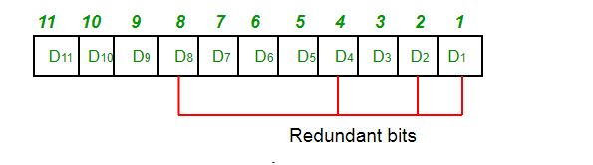
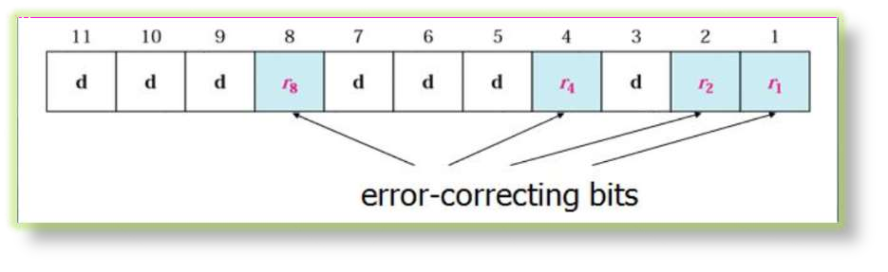
General Algorithm of Hamming code
Write the bit positions starting from 1 in binary form.
All the bit positions that are a power of 2 are marked as parity bits (1, 2, 4, 8, 16,32 , etc).
All the other bit positions are marked as data bits.

Slide 46
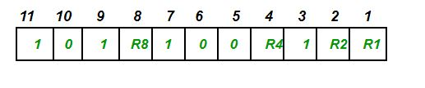
Suppose the data to be transmitted is 1011001, the bits will be placed as follows:

Slide 47
Each data bit is included in a unique set of parity bits, as determined its bit position in binary form.
a. Parity bit 1 covers all the bits positions (1, 3, 5, 7, 9, 11, etc).
b. Parity bit 2 covers all the bits positions (2, 3, 6, 7, 10, 11, etc).
c. Parity bit 4 covers all the bits positions (4–7, 12–15, 20–23, etc).
d. Parity bit 8 covers all the bits positions (8–15, 24–31, 40–47, etc).

Slide 48
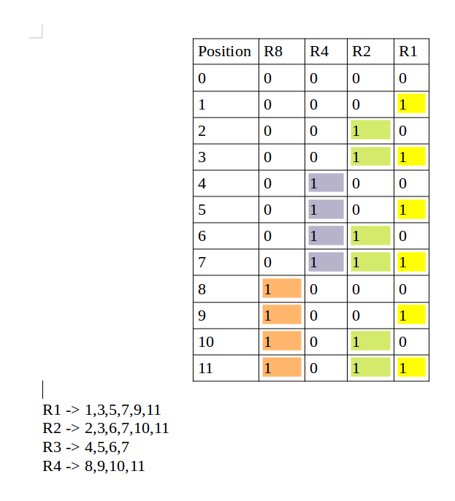

Slide 49
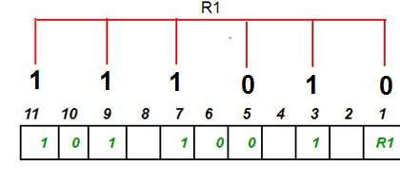
R1 bit is calculated using parity check at all the bits positions whose binary representation includes a 1 in the least significant position.R1: bits 1, 3, 5, 7, 9, 11.
To find the redundant bit R1, we check for even parity. Since the total number of 1’s in all the bit positions corresponding to R1 is an even number the value of R1 (parity bit’s value) = 0

Slide 50
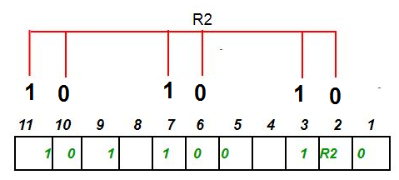
R2: bits 2,3,6,7,10,11.
To find the redundant bit R2, we check for even parity. Since the total number of 1’s in all the bit positions corresponding to R2 is odd the value of R2(parity bit’s value)=1

Slide 51
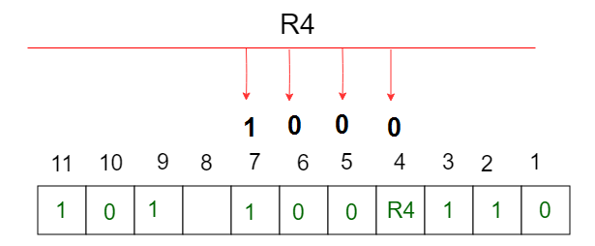
R4: bits 4, 5, 6, 7.
To find the redundant bit R4, we check for even parity. Since the total number of 1’s in all the bit positions corresponding to R4 is odd the value of R4(parity bit’s value) = 1

Slide 52
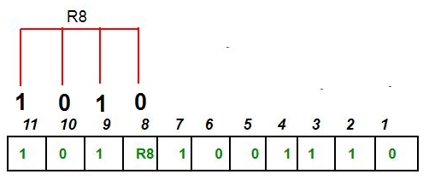
R8: bit 8,9,10,11
To find the redundant bit R8, we check for even parity. Since the total number of 1’s in all the bit positions corresponding to R8 is an even number the value of R8(parity bit’s value)=0.

Slide 53

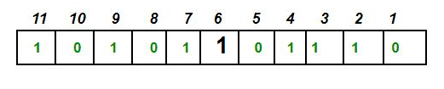
Thus, the data transferred is:
Suppose in the above example the 6th bit is changed from 0 to 1 during data transmission, then it gives new parity values in the binary number:

Slide 54
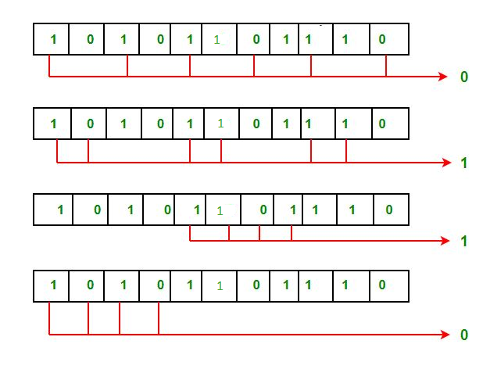
Error detection and correction
The bits give the binary number as 0110
R8R4R2R1
whose decimal representation is 6. Thus, the bit 6 contains an error. To correct the error the 6th bit is changed from 1 to 0

Slide 55
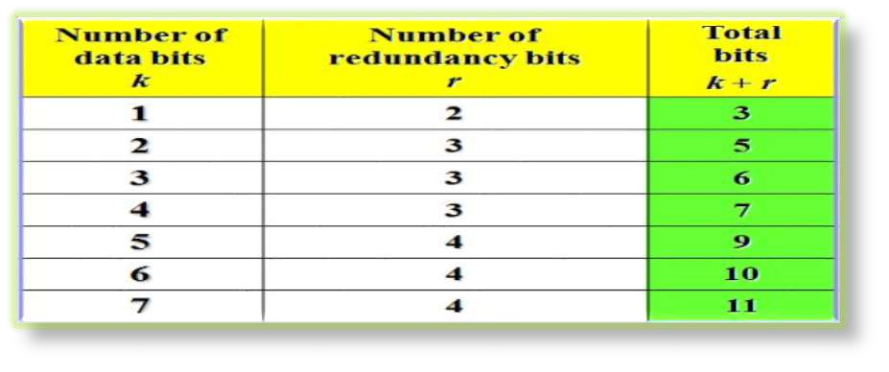
HAMMING CODE
Ex : If The Value of m is 7, the Relation will Satisfy if The Minimum Value of r is 4.
2^4 = 16 > 7+4+1
53

Slide 56


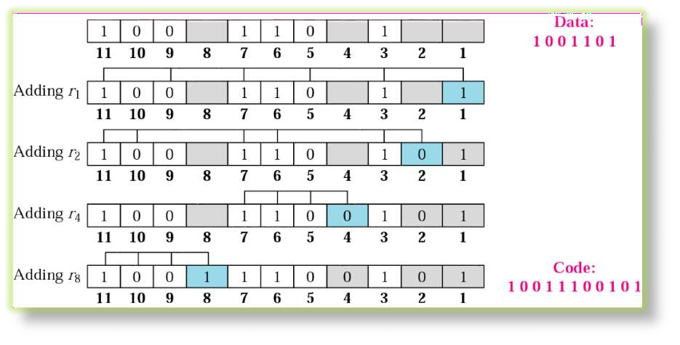
56

Slide 57
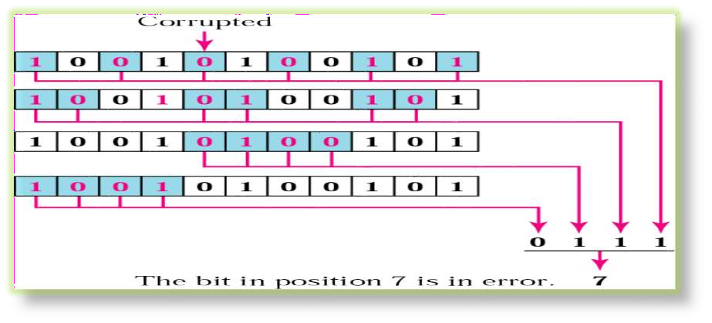

Slide 58
Burst Error Correction
Hamming Code Cannot Correct a burst Error Directly.
it is Possible To Rearrange The Data and Then Apply The code.
Instead of Sending All the bits in The data Unit Together, we can organize N units in a column.
Send The First bits of Each Followed by The Second bit of each, and so on.
In This Way, if a burst Error of M bit Occurs (M<N), Then The Error does not Corrupt M bit of Single Unit, it Corrupt Only 1 bit of Unit.
Then We Can Correct it Using Hamming Code Scheme.

Slide 59
FUNCTIONS AND REQUIREMENTS OF THE DATA LINK PROTOCOLS
The basic function of the layer is to transmit frames over a physical communication link. Transmission may be half duplex or full duplex. To ensure that frames are delivered free of errors to the destination station (IMP) a number of requirements are placed on a data link protocol. The protocol (control mechanism) should be capable of performing:
The identification of a frame (i.e. recognise the first and last bits of a frame).
The transmission of frames of any length up to a given maximum. Any bit pattern is permitted in a frame.
The detection of transmission errors.
The retransmission of frames which were damaged by errors.
The assurance that no frames were lost.
In a multidrop configuration -> Some mechanism must be used for preventing conflicts caused by simultaneous transmission by many stations.
The detection of failure or abnormal situations for control and monitoring purposes.
60
It should be noted that as far as layer 2 is concerned a host message is pure data, every single bit of which is to be delivered to the other host. The frame header pertains to layer 2 and is never given to the host.

Slide 60
Flow control
Flow control tells the sender how much data should be sent to the receiver so that it is not lost.
This mechanism makes the sender wait for an acknowledgment before sending the next data.
Or
When a data frame (Layer-2 data) is sent from one host to another over a single medium, it is required that the sender and receiver should work at the same speed.
That is, sender sends at a speed on which the receiver can process and accept the data. What if the speed (hardware/software) of the sender or receiver differs?
If sender is sending too fast the receiver may be overloaded, (swamped) and data may be lost.
There are two ways to control the flow of data:
1.Stop and Wait
2. Sliding Window

Slide 61
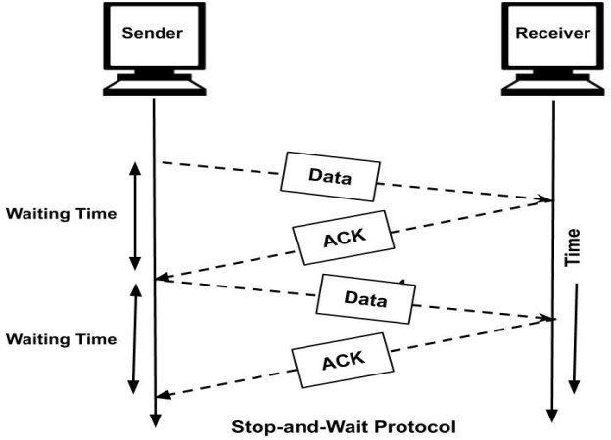
Stop and Wait
This flow control mechanism forces the sender after transmitting a data frame to stop and wait until the acknowledgement of the data-frame sent is received.
i.e., Sender sends one frame and waits for an acknowledgement before sending next frame.
Advantage:
Simplicity
Disadvantage:
Inefficiency,Slow

Slide 62
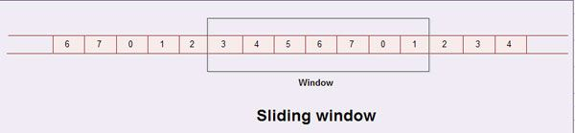
Sliding Window
In sliding window method, multiple frames are sent by sender at a time before needing an acknowledgment.
• Multiple frames sent by source are acknowledged by receiver using a single ACK frame.
The windows have a specific size in which the frames are numbered modulo- n, which means they are numbered from 0 to n-l.
For example, if the sending window size is 4, then the sequence numbers will be 0, 1, 2, 3, 0, 1, 2, 3, 0, 1, and so on.
if n = 8, the frames are numbered 0, 1,2,3,4,5,6, 7, 0, 1,2,3,4,5,6, 7, 0, 1, ….
For 7 frames

Slide 63
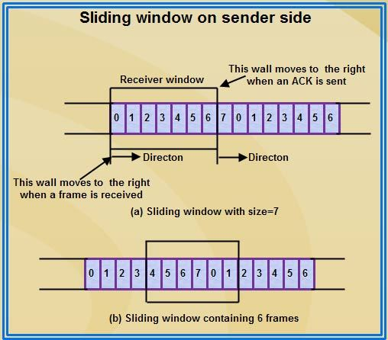

The sender’s window will now expand to include the next three frames in its buffer. At this point the sender’s window will contain six frames (4, 5, 6, 7, 0, 1).

Slide 64
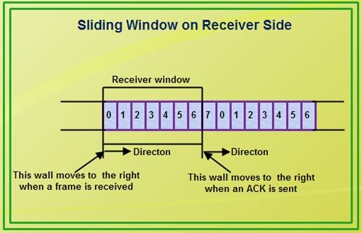
Therefore, the sliding window of sender shrinks from left when frames of data are sending. The sliding window of the sender expands to right when acknowledgments are received.
• The sliding window of the receiver shrinks from left when frames of data are received. The sliding window of the receiver expands to the right when acknowledgement is sent.

Slide 65
The size of the receiving window is the maximum number of frames that the receiver can accept at a time.
It determines the maximum number of frames that the sender can send before receiving acknowledgment.
When the receiver sends an ACK, it includes the number of next frame it expects to receive.
For example in order to acknowledge the group of frames ending in frame 4, the receiver sends an ACK containing the number 5. When sender sees an ACK with number 5, it comes to know that all the frames up to number 4 have been received.
Now, if an ACK numbered 3 is received by source, it means three frames (0, 1, 2) have been received by receiver and are undamaged.

Slide 66
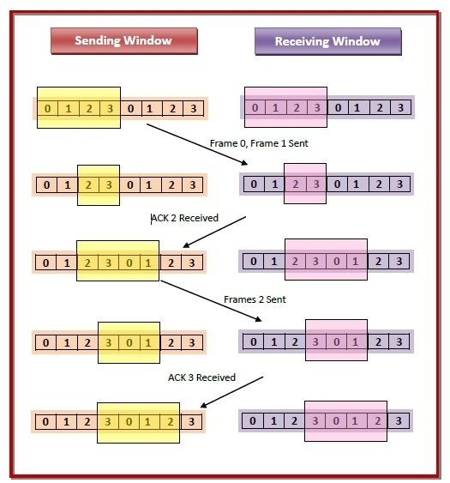

Slide 67
Error control
Error control in data link layer is the process of detecting and correcting data frames that have been corrupted or lost during transmission.
In case of lost or corrupted frames, the receiver does not receive the correct data-frame and sender is ignorant about the loss. Data link layer follows a technique to detect transit errors and take necessary actions, which is retransmission of frames whenever error is detected or frame is lost. The process is called Automatic Repeat Request (ARQ).

Slide 68
Phases in Error Control
Detection of Error − Transmission error, if any, is detected by either the sender or the receiver.
Acknowledgment − acknowledgment may be positive or negative.
  Positive ACK − On receiving a correct frame, the receiver sends a positive acknowledge.
  Negative ACK − On receiving a damaged frame or a duplicate frame, the receiver sends a negative acknowledgment back to the sender.
Retransmission − The sender maintains a clock and sets a timeout period. If an acknowledgment of a data-frame previously transmitted does not arrive before the timeout, or a negative acknowledgment is received, the sender retransmits the frame.

Slide 69
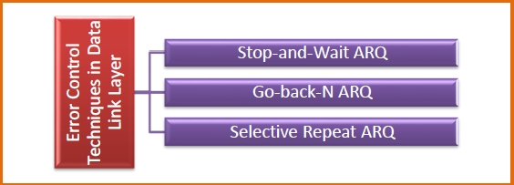
Error Control Techniques
There are three main techniques for error control

Slide 70
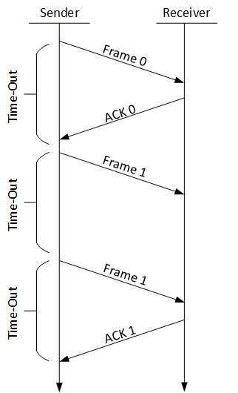
1.Stop-and-wait ARQ
The following transition may occur in Stop-and-Wait ARQ:
The sender maintains a timeout counter.
When a frame is sent, the sender starts the
timeout counter.
If acknowledgement of frame comes in time,
the sender transmits the next frame in queue.
If acknowledgement does not come in time,
the sender assumes that either the frame or
its acknowledgement is lost in transit.
Sender retransmits the frame and starts the
timeout counter.
If a negative acknowledgement is received,
the sender retransmits the frame.

Slide 71
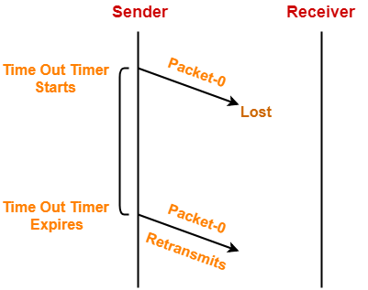
Stop & Wait ARQ overcoming the problem of a lost data packet
Time out timer helps to solve the problem of lost data packet.
After sending a data packet to the receiver, sender starts the time out timer.
If the data packet gets acknowledged before the timer expires, sender stops the time out timer.
If the timer goes off before receiving the acknowledgement, sender retransmits the same data packet.
After retransmission, sender resets the timer.
This prevents the occurrence of deadlock.

Slide 72
Lost Acknowledgement
Sequence number on data packets help to solve the problem of delayed acknowledgement.
Consider the acknowledgement sent by the receiver gets lost.
Then, sender retransmits the same data packet after its timer goes off.
This prevents the occurrence of deadlock.
The sequence number on the data packet helps the receiver to identify the duplicate data packet.
Receiver discards the duplicate packet and re-sends the same acknowledgement.

Slide 73
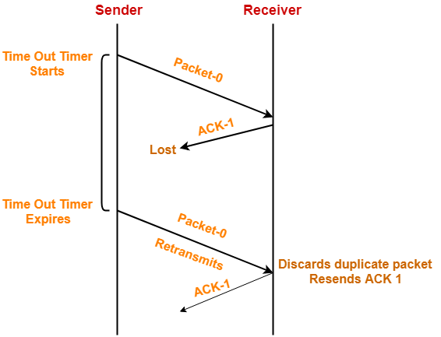

Slide 74
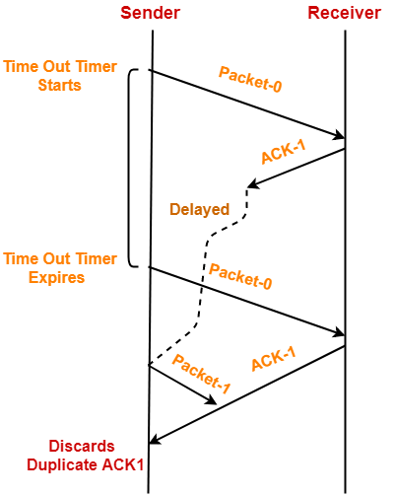
Delayed Acknowledgement

Slide 75
The problem of a damaged data packet
Whenever a data packet is damaged/corrupted, the receiver then sends negative feedback to the sender and then it resends the same data packet.
Limitations
The Stop & Wait ARQ is very less efficient because the sender window size is 1, which allows the sender to keep only one frame without feedback. So, the sender sends a data packet and waits for the feedback, and it gets the feedback it sends another data packet.
Improving Efficiency
In order to improve efficiency, we can increase the window size on both ends.

Slide 77
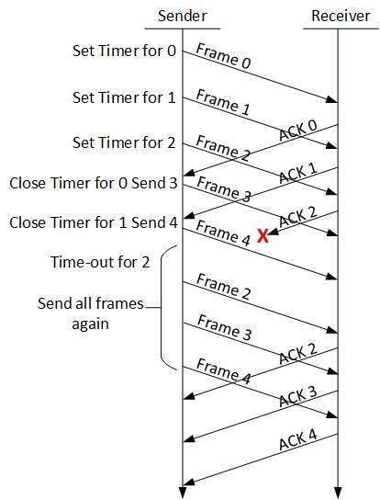
2.Go-Back-N ARQ
Stop and wait ARQ mechanism does not utilize the resources at their best.When the acknowledgement is received, the sender sits idle and does nothing. In Go-Back-N ARQ method, both sender and receiver maintain a window.

Slide 78
The sending-window size enables the sender to send multiple frames without receiving the acknowledgement of the previous ones. The receiving-window enables the receiver to receive multiple frames and acknowledge them. The receiver keeps track of incoming frame’s sequence number.
When the sender sends all the frames in window, it checks up to what sequence number it has received positive acknowledgement.
If all frames are positively acknowledged, the sender sends next set of frames.
If sender finds that it has received NACK or has not receive any ACK for a particular frame, it retransmits all the frames after which it does not receive any positive ACK.

Slide 79
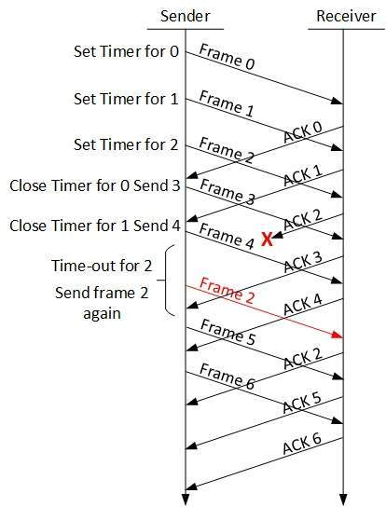
3.Selective Repeat ARQ
In Go-back-N ARQ, it is assumed that the receiver does not have any buffer space for its window size and has to process each frame as it comes. This enforces the sender to retransmit all the frames which are not acknowledged.
In Selective-Repeat ARQ, the receiver while
keeping track of sequence numbers, buffers the
frames in memory and sends NACK for only
frame which is missing or damaged.
The sender in this case, sends only packet for
which NACK is received.

